Slide 1
Darkstar
John, Ya-Ching, Akash, Lynne, Rick
Jesse

Slide 2
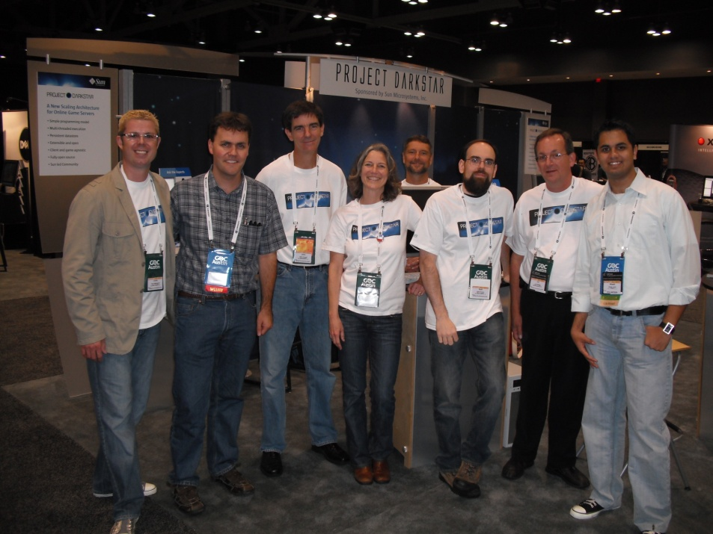
Client Project: SUn MicrosYsteMs
Point of Contact:
Jim Waldo
Project Darkstar Director:
Karl Haberl

Slide 3
CoNcept StateMeNt:
ReQUiReMeNts
Client:
Usability Testing.
ETC:
BVW Deployment.
Panda3D Integration.

Slide 4
CoNcept StateMeNt:
Goals
Client:
Comprehensive Usability Study
Inform the Community

Slide 5
CoNcept StateMeNt:
Goals
ETC:
BVW
Usage
Support
Feedback
Compiling into Panda3D.

Slide 6
DeliveraBles
Client:
Weekly reports.
Code submission.
Example games.

Slide 7
DeliveraBles
ETC:
Installation package.
Documentation.
Panda3D Installer.

Slide 8
WeeklY RepoRts
Results of usability testing.
Feedback from Sun.
Code included in the report.
Discussion on weekly conference call.

Slide 9
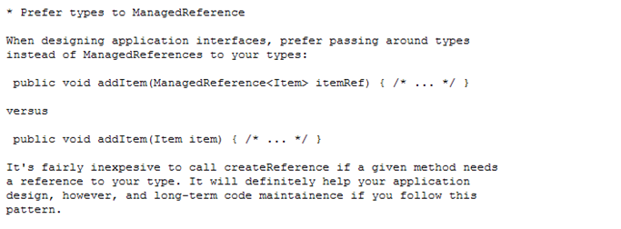
WeeklY RepoRts
Results of usability testing.
Feedback from Sun.
Code included in the report.
Discussion on weekly conference call.

Slide 10
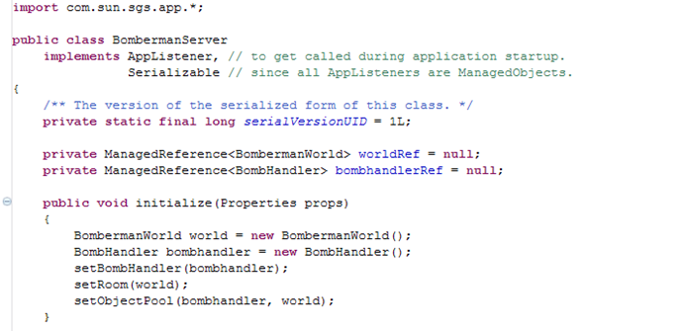
WeeklY RepoRts
Results of usability testing.
Feedback from Sun.
Code included in the report.
Discussion on weekly conference call.
JAVA CODE
Python CODE

Slide 11
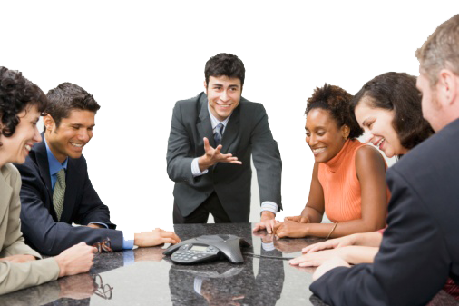
WeeklY RepoRts
Results of testing usability
Feedback from Sun
Code included in the report
Discussion on weekly conference call

Slide 12
GaMes
Making a significant number of small games.
Serve to teach us how to use Project Darkstar.
Well commented to serve as examples to others.
Then one large game.
Test Project Darkstar’s limits.
Pull everything we have learned from the mini-games together.

Slide 13
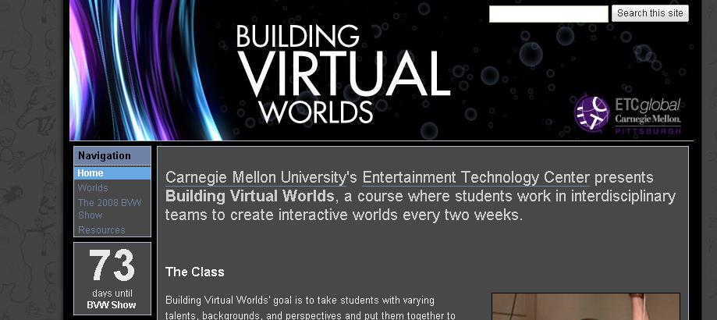
Risks
BVW
Where is the best place to demo the power of both Panda3D and Darkstar?
BVW!

Slide 14
How you can help
BVW
Installation packages is completed.
Step by step document.
Resource are all on-line and free.

Slide 15
We answer these
BVW
Installation packages is completed.
Step by step document.
Resource are all on-line and free.
Workshop for BVW programmers.
Considering using?

Slide 16
We answer these
BVW
Installation packages is completed.
Step by step document.
Resource are all on-line and free.
Workshop for BVW programmers.
Considering using? YES!
In next round?

Slide 17
We answer these
BVW
Installation packages is completed.
Step by step document.
Resource are all on-line and free.
Workshop for BVW programmers.
Considering using? YES!
In next round? Well…

Slide 18
We answer these
PaNda3d INtegratioN
Integrate client API into Panda3D.
Will not require a separate installation and configuration for client.

Slide 19
We answer these
ScHedUle
Warm up
Week 1~4
Learn Project Darkstar
Polish what we have
Week 14~16
Wrap up
Use what we learned
Week 9~13
Implement
Brain Storming
Week 5~8
Second batch
Warm Up:
Week 1: Learning how to use Project Darkstar
Week 2: Learning client/server interactions, Designing games
Week 3: Start making the first batch of mini games
Week 4: Finish the first batch of mini games

Slide 20
We answer these
ScHedUle
Warm up
Week 1~4
Learn Project Darkstar
Polish what we have
Week 14~16
Wrap up
Use what we learned
Week 9~13
Implement
Brain Storming
Week 5~8
Second batch
Second batch:
Week 5: Quarters, Start second batch of mini games
Week 6: Finish second batch of mini games
Week 7: One week “lightning round” mini game batch
Week 8: Designing the large game

Slide 21
We answer these
ScHedUle
Warm up
Week 1~4
Learn Project Darkstar
Polish what we have
Week 14~16
Wrap up
Use what we learned
Week 9~13
Implement
Brain Storming
Week 5~8
Second batch
Implementation:
Week 9: Halves, Work on large game
Week 10: Work on large game
Week 11: Work on large game, Alpha
Week 12: Work on large game, Beta
Week 13: Work on large game, User testing

Slide 22
We answer these
ScHedUle
Warm up
Week 1~4
Learn Project Darkstar
Polish what we have
Week 14~16
Wrap up
Use what we learned
Week 9~13
Implement
Brain Storming
Week 5~8
Second batch
Wrap Up:
Week 14: Softs, polish large game, incorporate faculty feedback
Week 15: Polish large game
Week 16: Finals

Slide 23
CHalleNges
Networked Multiplayer games are difficult.
Designing and Building a Large Multiplayer Game.
Supporting BVW while getting our Project Done.

Slide 24
Help
Any advice on the games would be great.
Scope, more, less, just right?
Game design feedback on both ideas and implementation.
We need Playtesters!

Slide 25
THank You
Come Visit us in Room 3414.
View Our Demos.

